Slide 1
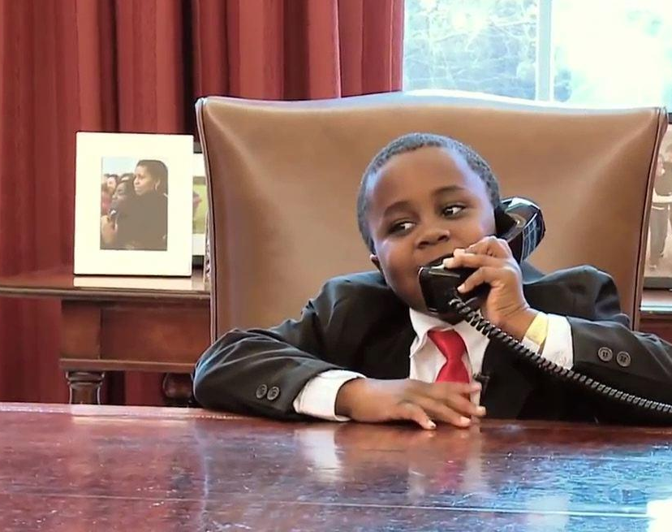
And the Children Shall Lead Us: A Guide to Interest-Based Learning
Matthew J. Zakreski, PsyD

Slide 2
Who am I?
Dr. Matt Zakreski – you can call me ”Dr. Matt” (Born and Raised in NJ)
I’m a clinical psychologist, professional speaker, and neurodivergence advocate
I’m known as someone who can bridge neuroscience and clinical practice to make skills accessible for you and your loved ones

Slide 3
Goals for Today
Define
Define what Interest-Based Learning is
Connect
Connect why Interest-Based Learning is effective for educating kids, but especially neurodivergent kids
Practice
Practice how to alter teaching practices towards Interest-Based Learning

Slide 4
What do you do for a living?
What do you do for fun?

Slide 5

I need THREE volunteers

Slide 6
Interest-Based Learning
Interest-based learning (IBL) occurs when students identify their interests and use those interests to drive and lead learning experiences.
The purpose of designing learning experiences around interests is to encourage an intrinsic motivation to learn and inspire a passion for learning.
IBL channels the inherent eagerness of kids to learn about things they like into a guided cycle of asking questions and finding answers.
IBL is a process for expanding inquiry and discovery to increase engagement in learning, which ideally generalizes to other subjects

Slide 7

Engagement
Student engagement is “the mental state students are in while learning, representing the intersection of feeling and thinking.”
Engaged students make meaning with the content they are presented with rather than passive absorption
Highly personal and personalized process
Intersection of motivation and higher-order thinking
Engagement comes in three areas:
Cognitive
Affective
Behavioral

Slide 8
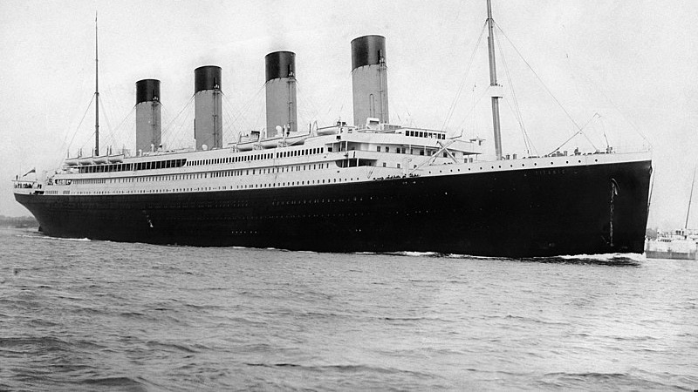
Case Example

Slide 9

Cognitve Engagement
Cognitive: the extent to which students are attending to and spending mental effort on the learning tasks encountered
What cognitive engagement looks like
Being curious, wanting to understand
Psychological and intellectual investment in learning
Using strategies that lead to deep learning
Personal transformation of information

Slide 10
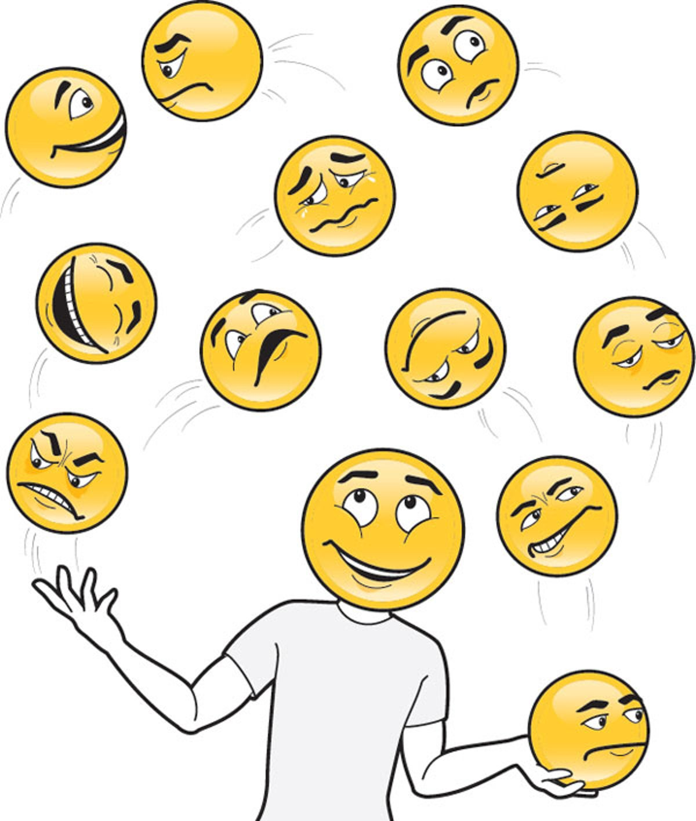
Affective Engagement
Affective: the level of students’ investment in, and their emotional reactions to, the learning tasks
What engagement looks like
Students care about their learning
Interest, enthusiasm, and excitement about what they are doing
Motivated and challenged by new things – productive struggle
Willing to participate in the learning process in multiple ways

Slide 11

Behavioral Engagement
Behavioral: the extent to which students are making active responses to the learning tasks presented
What engagement looks like
Asking or answering questions
Going to class
Paying and sustaining attention
More behavioral regulation

Slide 12
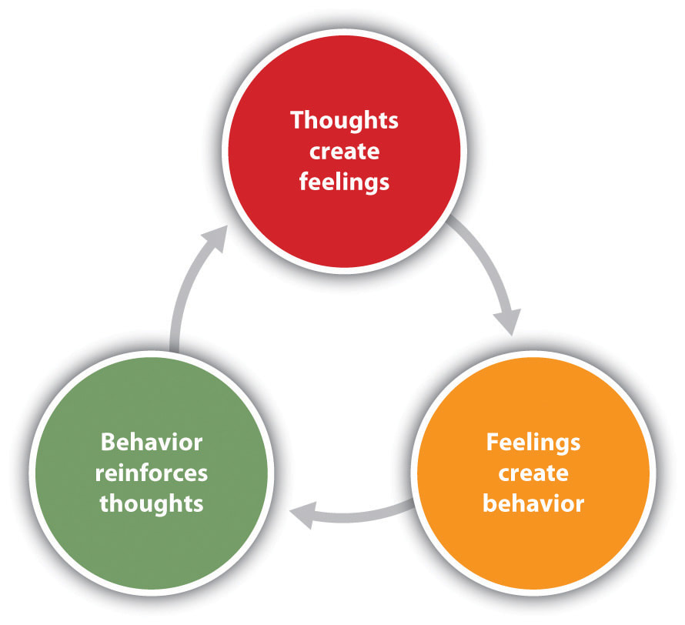

Slide 13
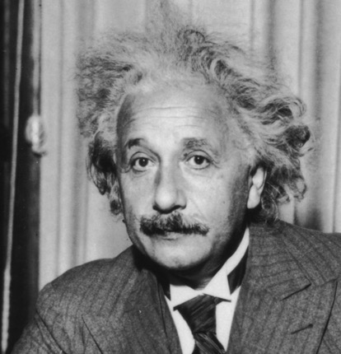
Learning as we go
Interests are intrinsic
As we engage more, we naturally learn more
Assumes competence and ability – what does regular education look like?
To level up, you must build skills
Social and emotional
Research
Learning
Demonstration
Communication
Executive Functioning
Einstein and physics vs. math

Slide 14
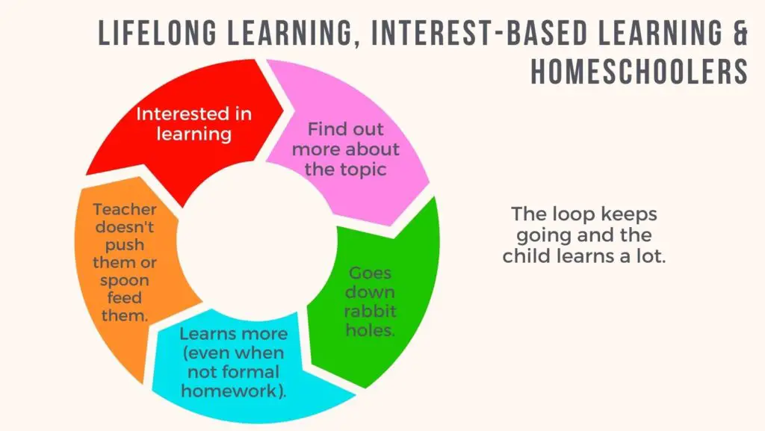


Slide 15
Differentiated Instruction
Differentiated Instruction (Carol Tomlinson) is the gold standard of how to adapt classrooms to the educational needs of gifted and 2E learners
DI is a student-centered, interest-driven approach to adapting curricula (we teach the students we HAVE, not the students we WANT to have)
In DI, the teacher anticipates the differences in students' readiness, interests, and learning profiles
DI creates different learning paths so that students can learn as much as they can as deeply as they can, without
undue anxiety because the assignments are too taxing
boredom because they are not challenging enough.

Slide 16
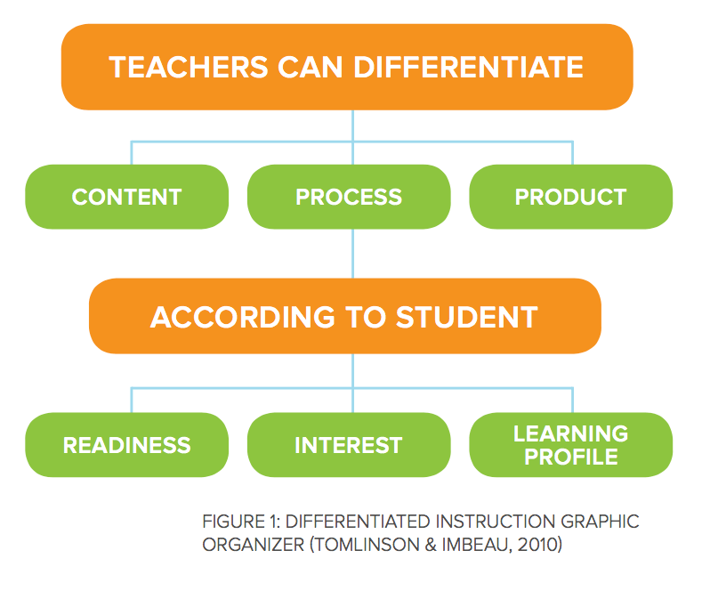

Slide 17
Pop Quiz Time!
25 Question Chapter Test
Five-page paper
10-minute Presentation

Slide 18
The Power of Choice
It’s not Teachers vs. Students – we are co-creating learning
Offering choice shows students that you are actively engaged in teaching and that you’re aware WHO you are teaching
Remove choice and you breed passivity or even defiance.
Openness to compromise offers students scaffolded opportunities to
Practice decision-making
Explore their academic identity
Manage expectations and consequences
Connect their learning to interests and passions

Slide 19
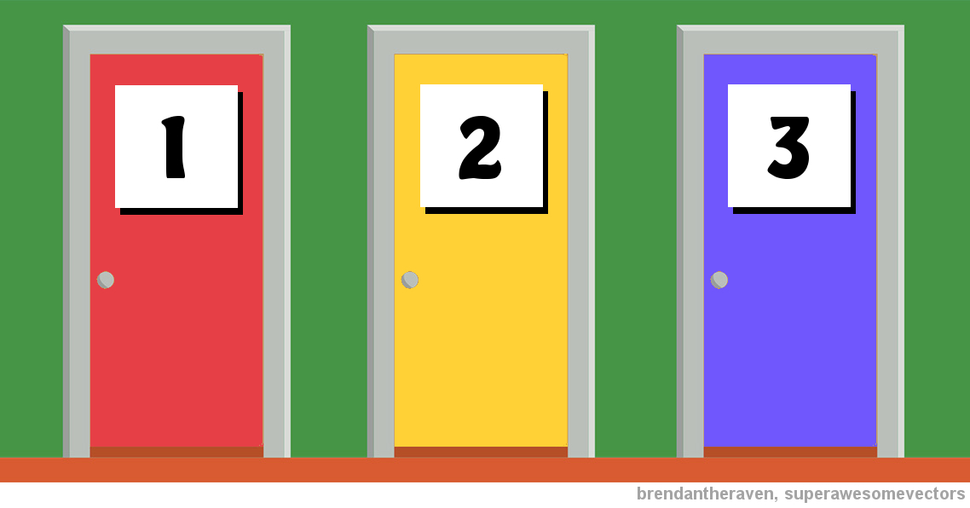

Slide 20
The Eight Steps of IBL
Interest Finding
Interest Focusing
Action Plan
Gathering Resources
Research and Design
Products
Authentic Audience
Debrief and Celebrate

Slide 21
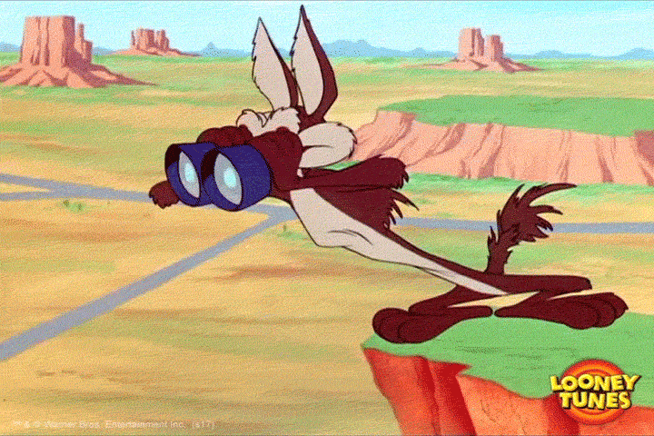
Step One: Interest Finding
Once students have been introduced to the concept of IBL, it is time to identify their interest areas.
Creating safety and vulnerability in the classroom
Modeling openness
There are NO BAD IDEAS
Surveys
Peer Feedback
Strengths

Slide 22

Step Two: Interest Focusing
Conference with each student to explore how an interest area can be transformed into a workable inquiry question.
Inquiry Question: Tend to be too big
This process involves the use of:
Webbing
Exemplars
Whole-class guided practice
Another round of individual conferences with students

Slide 23

Step Three: Action Plan
Completed collaboratively by the students and teacher
The action plan includes:
Places for students to track their goals
Timelines
Available resources
Evidence that will be used to document growth.
Teachers will also keep a record of project timelines, tasks, and standards addressed. (share with parents)

Slide 24
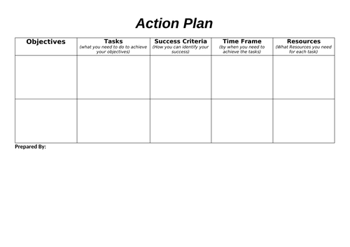

Slide 25

Step Four: Gathering Resources
The teacher guides the student in locating and validating credible primary and secondary sources to support their research.
More Knowledgeable Others (MKO)
Community Resources
Documentaries, books, articles, interviews, etc.
What are NOT credible resources?

Slide 26

Step Five: Research and Design
The longest part of the process
Three types:
Informational
Experimental
Tinkering

Slide 27
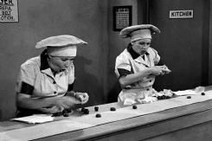
Step Six: Products
Final products can be ANYTHING, depending on the question:
as simple as a one-pager
as complex as an iMovie
Creating and performing a scientific experiment.
What all IBL products share is that they are authentic and useful to the problem being researched.

Slide 28

Step Seven: Authentic Audience
Students present their research to an authentic audience.
Emotional Regulation
Social Skills
Presentation Skills
Presenting their work motivates students and empowers them to identify as problem solvers whose work has value in the community.

Slide 29

Step Eight: Debrief and Celebrate
Debriefing is a reflective technique used to gauge how successful, useful, and/or beneficial a learning journey was
Helps to determine what could have been better for key constituents.
It solidifies learning and takes it the "next step."
Debriefing can be organized around three categories of questions:
What Happened?
So what?
Now what?

Slide 30

Then….

Slide 31
Why is having fun important?
Play is the work of childhood
People learn faster through fun activities
Reinforces learning and exploration
Gives us the dopamine

Slide 32

But Wait…
Life isn’t fair!
Life isn’t always about getting what you want!
I didn’t have these things and I turned out fine!

Slide 33
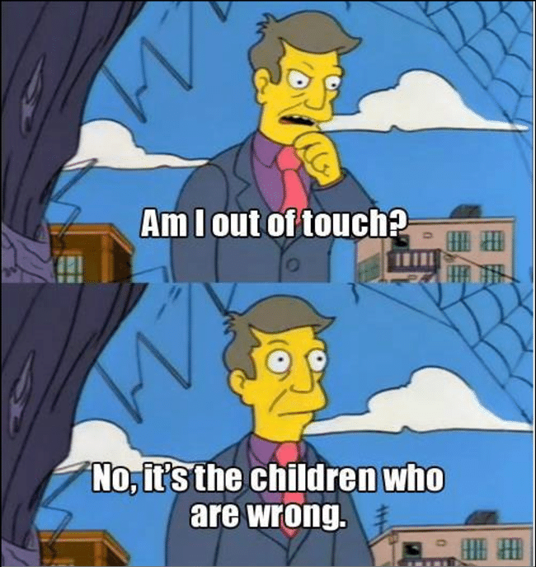

Slide 34
We Can Connect Anything to Anything
What Do You Want to Talk About?
What Do You Need to Learn About?
How Do You Like To Produce Your Work?

Slide 35
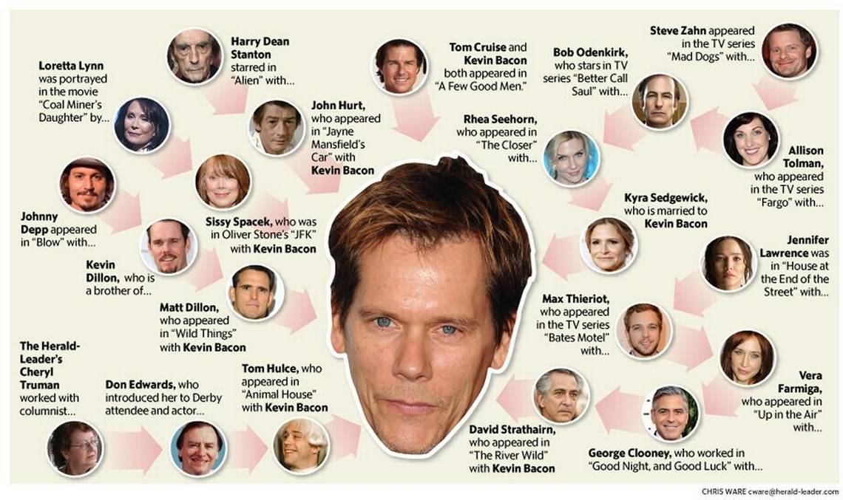
Let’s Put This Into Action

Slide 36
IBL Outcomes
Kids are more engaged in the learning process
Kids retain more and can use info more effectively
Kids develop more autonomy and independence skills
Kids demonstrate more social-emotional growth
Teachers (and parents!) are less burned out
Results are more aligned with 21st Century Skills

Slide 37
Our kids will show us the way… if we let them
IBL is a research-based educational strategy that leverages intrinsic motivation and interest to engage learners
We can connect anything to anything - Content can be taught along the way
Instruction can be differentiated along readiness, interest, delivery, and content
IBL naturally involves a social-emotional growth component
Resiliency grows more naturally through intrinsic motivation
21st Century Skills generalize and prepare us for a changing world

Slide 38
Questions?
Email: drmatt@theneurodiversitycollective.com
Facebook: www.facebook.com/drmattzakreski
Website: www.theneurodiversitycollective.com

Slide 39
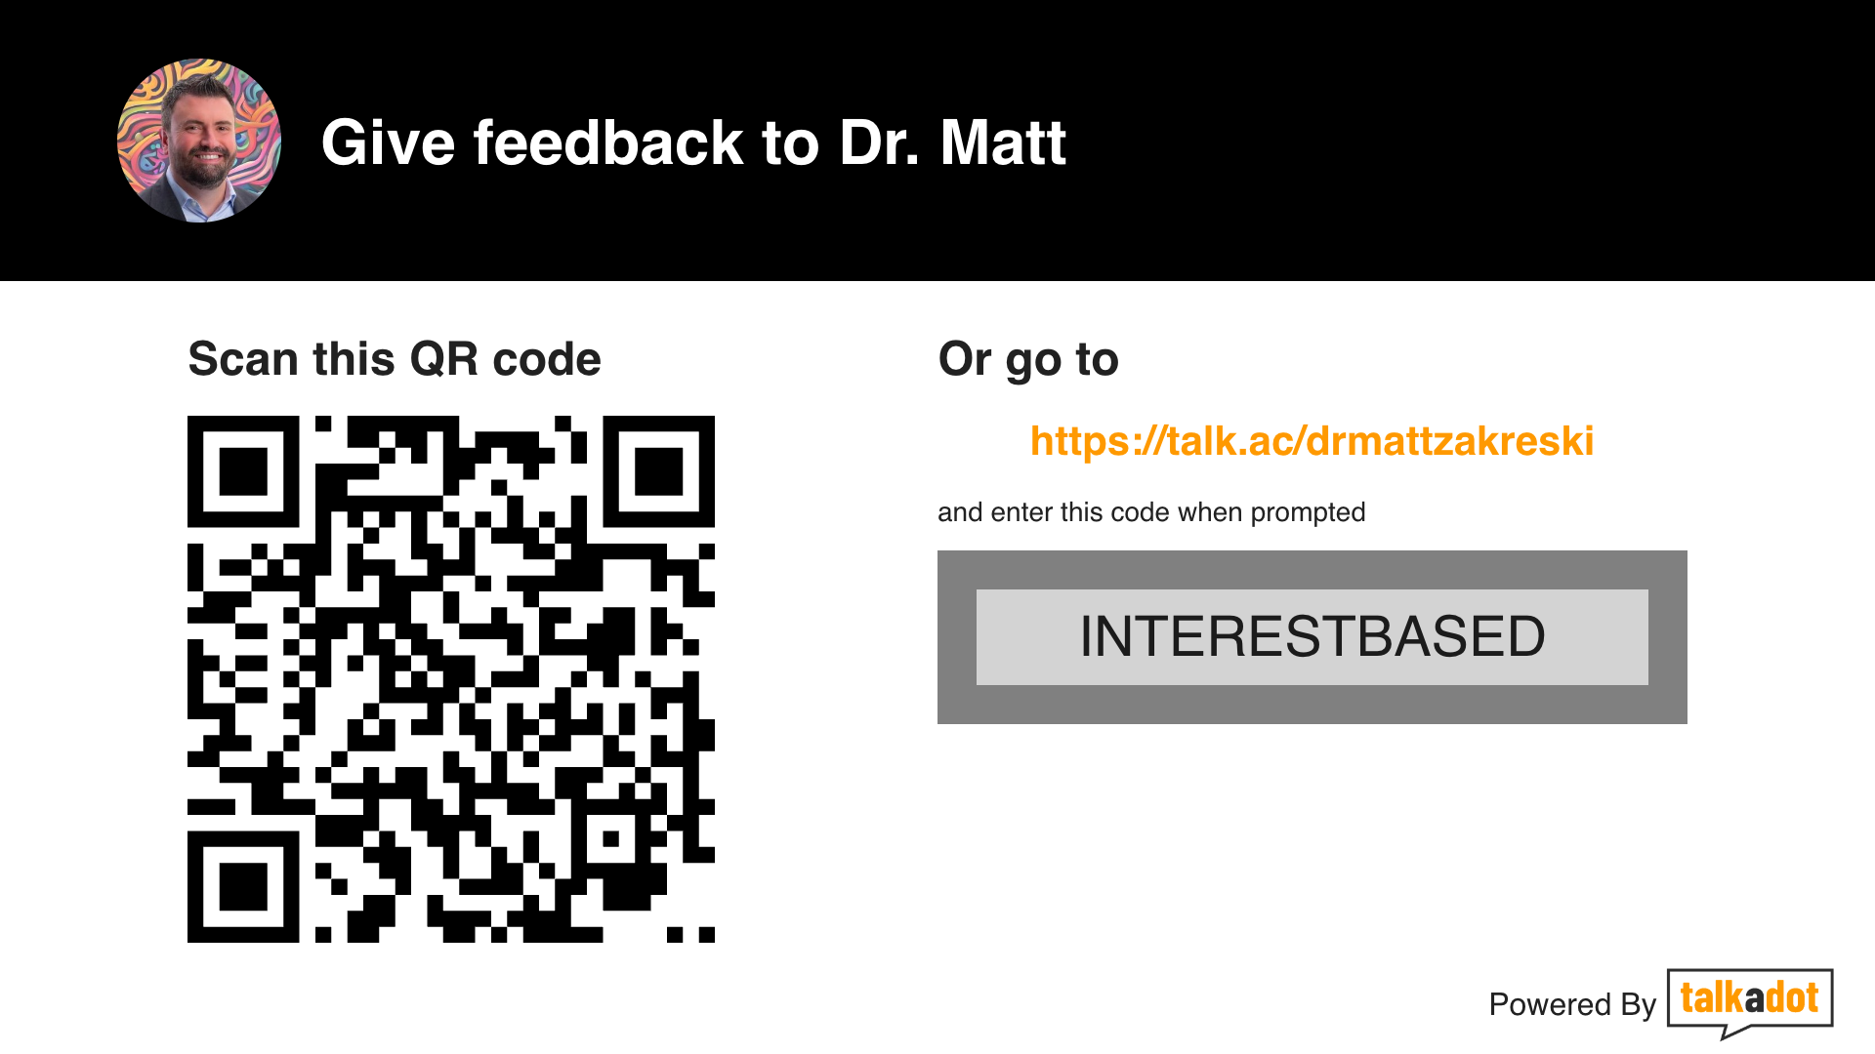

Slide 40
Additional Resources
https://www.ascd.org/el/articles/a-blueprint-for-interest-based-learning
https://ischoolconnect.com/blog/types-of-research-designs-and-how-they-can-help/
https://www.connectionsacademy.com/support/resources/article/how-do-interest-based-learning-activities-support-learning/
https://www.experientiallearningdepot.com/experiential-learning-blog/interest-led-learning-it-all-starts-with-a-question
https://howdoihomeschool.com/interest-based-learning-benefits-theory/
https://www.edutopia.org/topic/interest-based-learning/
https://ecpcprofessionaldevelopment.dec-sped.org/interest-based-child-learning-practice-guide/
https://www.colorado.edu/center/teaching-learning/2023/01/23/facilitating-and-assessing-student-engagement-classroom
https://www.edutopia.org/article/importance-student-choice-across-all-grade-levels/
https://teneoresults.com/blog/why-celebration-is-more-important-than-ever%E2%80%95especially-on-blue-monday/

Slide 41
References
Bondie, R. S., Dahnke, C., & Zusho, A. (2019). How does changing “one-size-fits-all” to differentiated instruction affect teaching?. Review of Research in Education, 43(1), 336-362.
Chen, C. H., & Yang, Y. C. (2019). Revisiting the effects of project-based learning on students’ academic achievement: A meta-analysis investigating moderators. Educational Research Review, 26, 71-81.
Farmana, Y., & Wonua, A. R. (2021). Optimizing Kahoot! Platform As Digital Media To Increase The Students’ Interest And Motivation In Learning English (Case Study At English As General Subject In STIE Enam Enam Kendari). International Journal of Educational Research and Social Sciences (IJERSC), 2(5), 1255-1261.
Hunter, J., Syversen, K. B., Graves, C., & Bodensteiner, A. (2020). Balancing Outdoor Learning and Play: Adult Perspectives of Teacher Roles and Practice in an Outdoor Classroom. International Journal of Early Childhood Environmental Education, 7(2), 34-50.
LaForce, M., Noble, E., & Blackwell, C. (2017). Problem-based learning (PBL) and student interest in STEM careers: The roles of motivation and ability beliefs. Education Sciences, 7(4), 92.
Magner, U. I., Schwonke, R., Aleven, V., Popescu, O., & Renkl, A. (2014). Triggering situational interest by decorative illustrations both fosters and hinders learning in computer-based learning environments. Learning and instruction, 29, 141-152.
Rotgans, J. I., & Schmidt, H. G. (2011). The role of teachers in facilitating situational interest in an active-learning classroom. Teaching and teacher Education, 27(1), 37-42.
Rotgans, J. I., & Schmidt, H. G. (2012). Problem-based learning and student motivation: The role of interest in learning and achievement. One-day, one-problem: An approach to problem-based learning, 85-101.
Schwartz, M., Hijazy, S., & Deeb, I. (2021). The role of play in creating a language-conducive context in a bilingual preschool. European Early Childhood Education Research Journal, 29(3), 381-396.
Stavholm, E., Lagerlöf, P., & Wallerstedt, C. (2022). Re-mediation in Early Childhood Teachers’ Reasoning about their Role in Play: An Empirical Study of the Learning Process of a Work Team. Early Years, 1-15.
Tan, O. S. (2021). Problem-based learning innovation: Using problems to power learning in the 21st century. Gale Cengage Learning.
Tatiana, S., Hanna, J., Kristiina, M., Jouni, P., & Sanna, J. (2022). The changes in lower secondary school students’ interest during collaborative learning. Scandinavian Journal of Educational Research, 66(7), 1127-1140.

